Slide 1
How to file a provisional patent application for your new invention
Gregory T. Kavounas, CEO
Patent Introductions, Inc.
(also a Patent Attorney in the US)
The most updated version of this presentation can be downloaded from:
www.patent-introductions.com/provisional.html

Slide 2
Orientation
This powerpoint presentation helps you file a provisional patent application in the US for your new invention, so you can get “Patent Pending” status.
Disclaimers: This presentation, plus all associated materials, websites, etc. do not contain legal advice. Downloading them, using them, relying on them, etc., is not receiving legal advice, and does not form any relationship with Patent Introductions, Inc., or with the author of this document. To receive legal advice, engage a patent attorney and ask them for a consultation about your individual circumstances.

Slide 3
Orientation
Provisional Filing Portal™ webpage:
This powerpoint presentation has a home webpage, at: www.patent-introductions.com/provisional.html,
also called the Provisional Filing Portal™ webpage.
In that Provisional Filing Portal™ webpage you can find help:
the most updated version of this presentation,
preliminary considerations about filing a provisional,
a template for starting the Specification Document for your invention, which you will file as your provisional,
instructions for preparing to file according to this presentation, including obscure formattings, etc.

Slide 4
Orientation
In fact, to understand what follows, we ask that you start from the entire Provisional Filing Portal™ webpage, and do as it says.
www.patent-introductions.com/provisional.html
The Provisional Filing Portal™ webpage will refer you back to the latest version of this powerpoint presentation, slide-by-slide.

Slide 5
Preparing your desktop
You have two desktops:
1) Your physical desktop: Prepare a credit card, for paying the filing fees to the USPTO.
2) Your computer desktop: All remaining instructions for your desktop are intended for your computer desktop.

Slide 6
Preparing your desktop
Your
computer
desktop

Slide 7
Preparing your desktop
Plan small windows for the files of interest …
(files to upload)
(filing support)
Your
computer
desktop

Slide 8
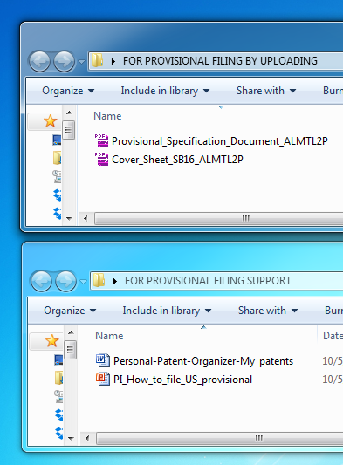
Preparing your desktop
Example:
These are the files of interest (get from Portal):
FOR PROVISIONAL FILING BY UPLOADING
[ v ] a closed copy of your prepared Specification Document pdf, with filename and saved as described in the Provisional Home Webpage (else it may not be “validated”),
[ v ] a closed copy of your filled-in Cover Sheet,
[ x ] if you qualify for, and want to claim the deepest discount in the filing fees of “Small Entity status”, a closed copy of your filled-in form SB/15A (not shown here)
FOR PROVISIONAL FILING SUPPORT
[ v ] a copy of Personal Patent Organizer (optional), and
[ v ] an open copy of this presentation, for screen-by- screen guidance

Slide 9
Preparing your desktop
So, these windows are as we said. In addition…

Slide 10
Preparing your desktop
Arrange your desktop so

Slide 11
Preparing your desktop
Arrange your desktop so you can flip repeatedly
between this
(this
presen-
tation)

Slide 12
Preparing your desktop
Arrange your desktop so you can flip repeatedly
between this and this
(USPTO
website)
(this
present-
ation)

Slide 13
Preparing your desktop
Arrange your desktop so you can flip repeatedly
between this and this and back again …
(USPTO
website)
(this
presen-
tation)

Slide 14
Filing Stage – Launch
While here, …
(USPTO
website)
(this
present-
ation)

Slide 15
Filing Stage – Launch
While here, launch into this window:
https://efs.uspto.gov/EFSWebUIUnregistered/EFSWebUnregistered
(this
present-
ation)

Slide 16
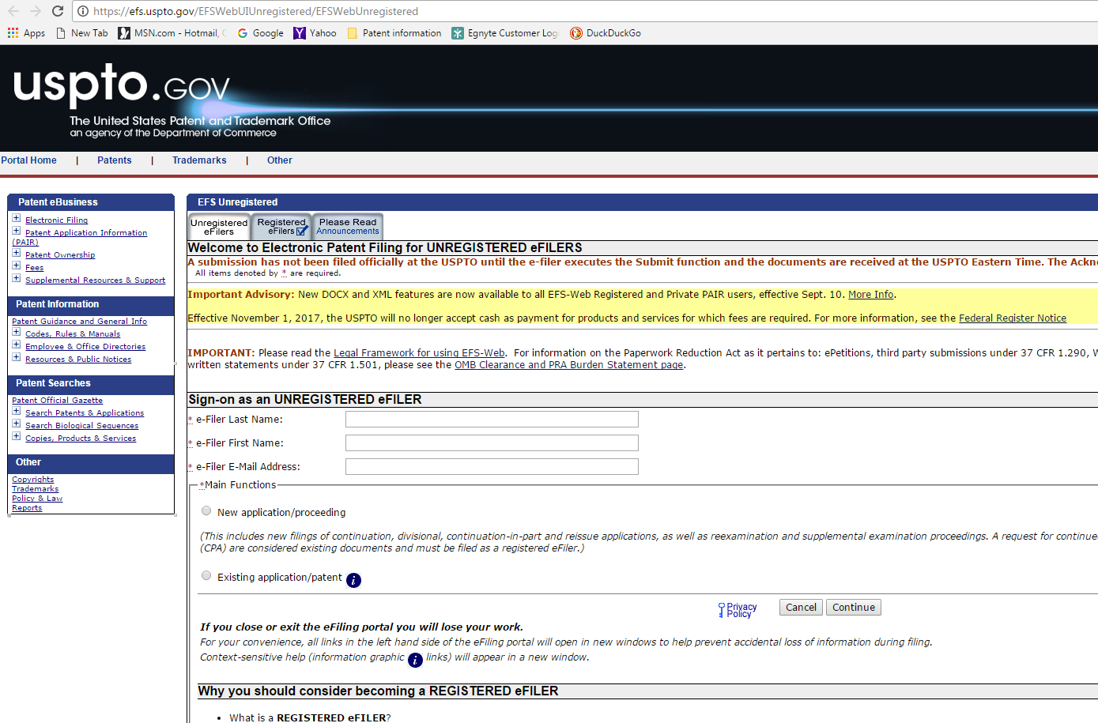
Filing Stage – Data Entry
You get this screen …

Slide 17
Filing Stage – Data Entry
Focus on this part

Slide 18
Filing Stage – Data Entry
You are the e-Filer (regardless of who is the inventor).
Enter your name here & your email address here

Slide 19
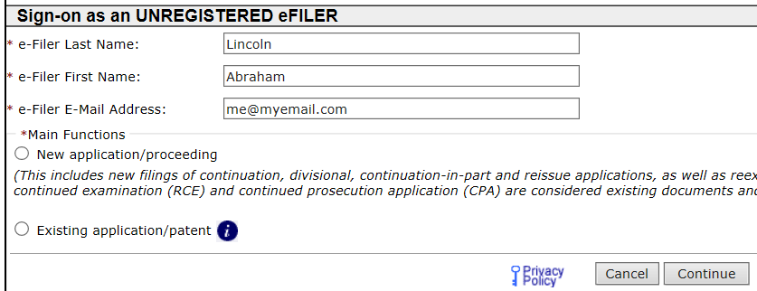
Filing Stage – Data Entry
Then click this button for your new patent application.

Slide 20
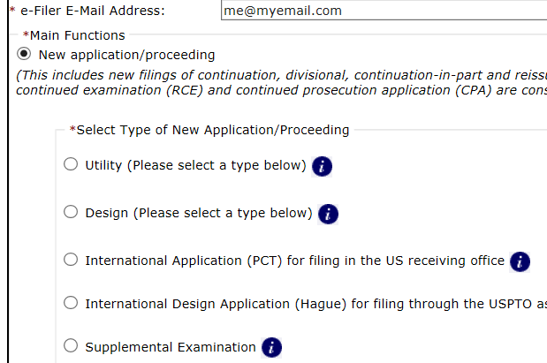
Filing Stage – Data Entry
Then click this button for your provisional application.

Slide 21
Filing Stage – Data Entry
Then click this button for your provisional application.

Slide 22
Filing Stage – Data Entry
Then, below that, find and click “Continue”.
(“Continue” is how you get to the next screen, when ready with this screen.)

Slide 23
Filing Stage – Data Entry
Ensure this button is checked (the other will ask you for more information, which is already in your cover page).

Slide 24
Filing Stage – Data Entry
Copy & paste your Title, Docket No. exactly as they appear in your Specification Document

Slide 25
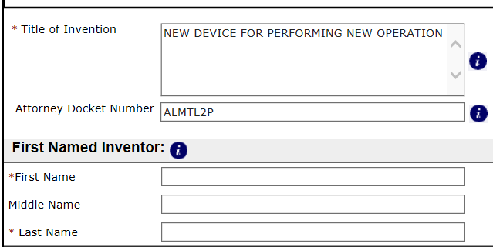
Filing Stage – Data Entry
Then copy the name of only the first inventor
(for reference only; any additional inventors will become known from the Cover Sheet)

Slide 26
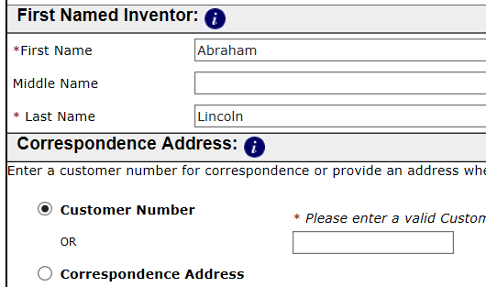
Filing Stage – Data Entry
Then click this button.

Slide 27
Filing Stage – Data Entry
Enter this information for you, the e-Filer; this must match similar information in the Cover Sheet.
Then, click “Continue”.

Slide 28
Filing Stage – Data Entry
The Application data has now been defined. Check this screen to see everything is right so far. To fix, click here

Slide 29
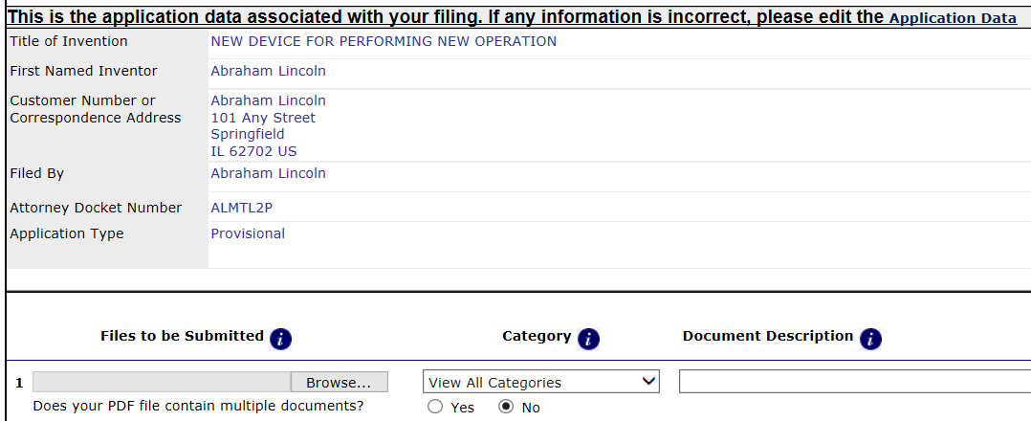
Filing Stage – Prepare Upload
This is also the screen for uploading the files that will be submitted electronically.

Slide 30
Filing Stage – Prepare Upload
This asks for the first file you want to upload.

Slide 31
Filing Stage – Prepare Upload
Click on “Browse …”,

Slide 32
Filing Stage – Prepare Upload
Click on “Browse …”,
find your Specification Document (your desktop or…)

Slide 33
Filing Stage – Prepare Upload
Click on “Browse …”,
find your Specification Document (your desktop or…)
Example:

Slide 34
Filing Stage – Prepare Upload
Click on “Browse …”,
find your Specification Document (your desktop or…), and
click “Open”.
Example:

Slide 35
Filing Stage – Prepare Upload
For this file, now, click on arrow;
from the drop-down menu, choose: Specification.

Slide 36
Filing Stage – Prepare Upload
Your screen should now look like this

Slide 37
Filing Stage – Prepare Upload
Your screen should now look like this; the first file is prepared for uploading.

Slide 38
Filing Stage – Prepare Upload
Your screen should now look like this; the first file is prepared for uploading.
Now click on “Add File” for your next file to upload.

Slide 39
Filing Stage – Prepare Upload
Click on “Browse …”,

Slide 40
Filing Stage – Prepare Upload
Example:
Click on “Browse …”,
find your Cover Sheet (desktop or …)

Slide 41
Filing Stage – Prepare Upload
Example:
Click on “Browse …”,
find your Cover Sheet (desktop or …), and
click “Open”.

Slide 42
Filing Stage – Prepare Upload
Then, for this file, from the dropdown menu choose: Provisional Cover Sheet (SB16).

Slide 43
Filing Stage – Prepare Upload
Only file(s) missing now: if you will be certifying Micro Entity status for the biggest discount, browse, find your PTO/SB/15A form; Document Description: Certification of MicroEntity (Gross Income Basis).
Repeat this last file for each co-inventor.

Slide 44
Filing Stage – Prepare Upload
If not a Micro-Entity, you have finished this stage, and …

Slide 45
Filing Stage – Validate
… click this to (Upload &) Validate all the documents you have lined up, …

Slide 46
Filing Stage – Validate
… click this to (Upload &) Validate all the documents you have lined up, …
… and then wait a little …

Slide 47
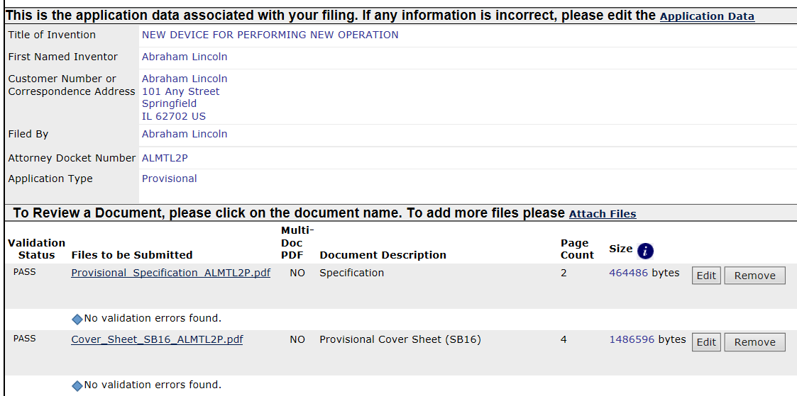
Filing Stage – Validate
Then: look here for any red marks.

Slide 48
Filing Stage – Validate
Then: look here for any red marks.
If a file has a red mark, remove it, fix it (see Provisional Home Page), repeat.

Slide 49
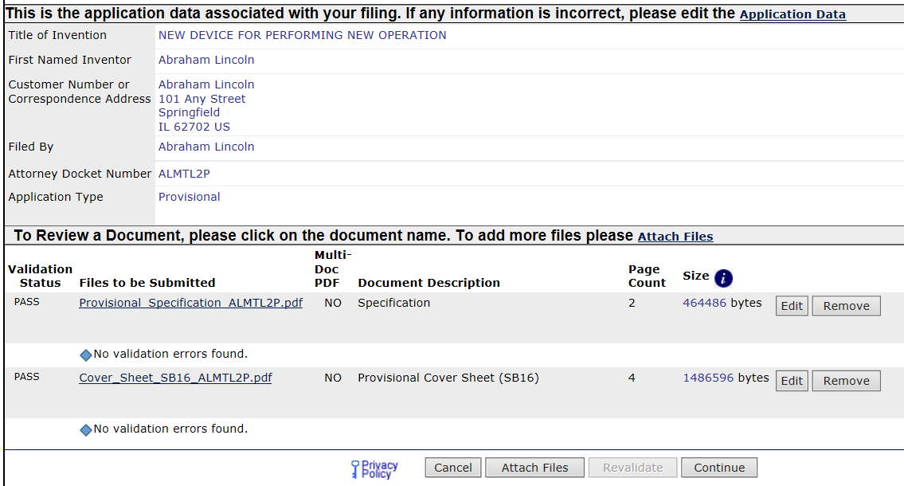
Filing Stage – Validate
When ready, click Continue.

Slide 50
Filing Stage – Determine Fees
This next screen is for determining how much you will need to pay.

Slide 51
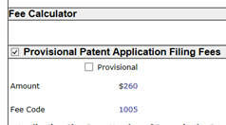
Filing Stage – Determine Fees
This is the “Regular” fee amount for a provisional (2018).

Slide 52
Filing Stage – Determine Fees
First, determine (from Provisional Home Page) whether you qualify for an Entity Status (Small- or Micro-) that would entitle you to a discount.
Suppose you qualify for, and click “Small Entity” …

Slide 53
Filing Stage – Determine Fees
this is what your screen will look like - the amount has become less.

Slide 54
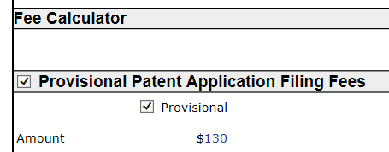
Filing Stage – Determine Fees
Check this box.

Slide 55
Filing Stage – Determine Fees
Ensure this is checked, if appropriate (lessens your fees!)

Slide 56
Filing Stage – Determine Fees
Enter here the number of pages of your Specification Document (fees increase for Specification Documents with many pages).

Slide 57
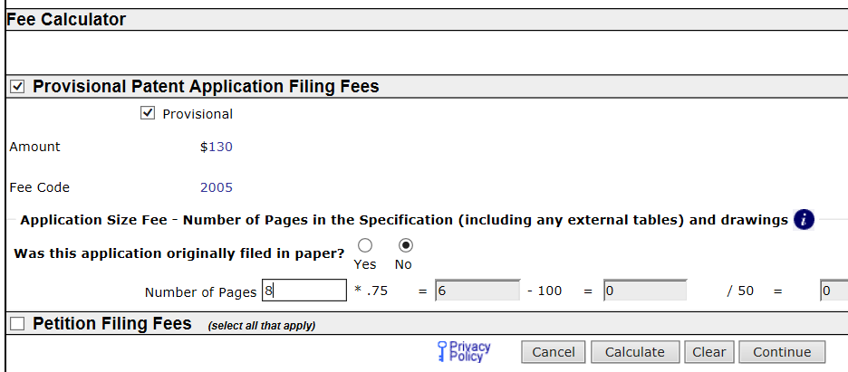
Filing Stage – Determine Fees
In this example, for the Specification Document having 8 pages, you pay $0 extra.

Slide 58
Filing Stage – Determine Fees
Then, click on Calculate.

Slide 59
Filing Stage – Determine Fees
Confirm that a non-zero amount appears here.
Then click “Continue” at the bottom, for the next screen.

Slide 60
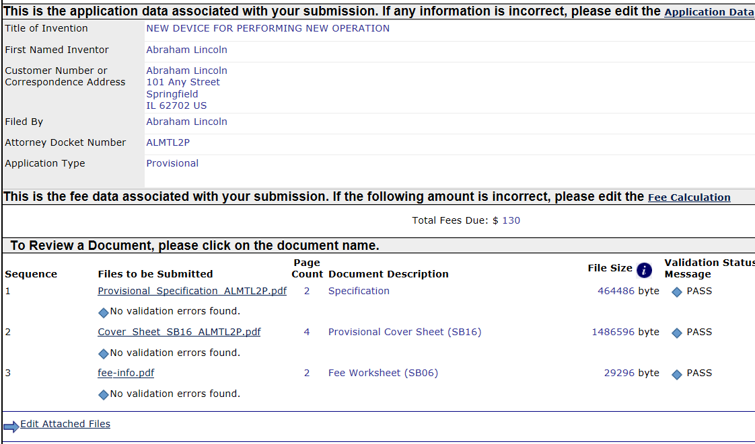
Filing Stage – Determine Fees
You are back to the upload screen. This new file has been generated, and added to your impending filing.

Slide 61
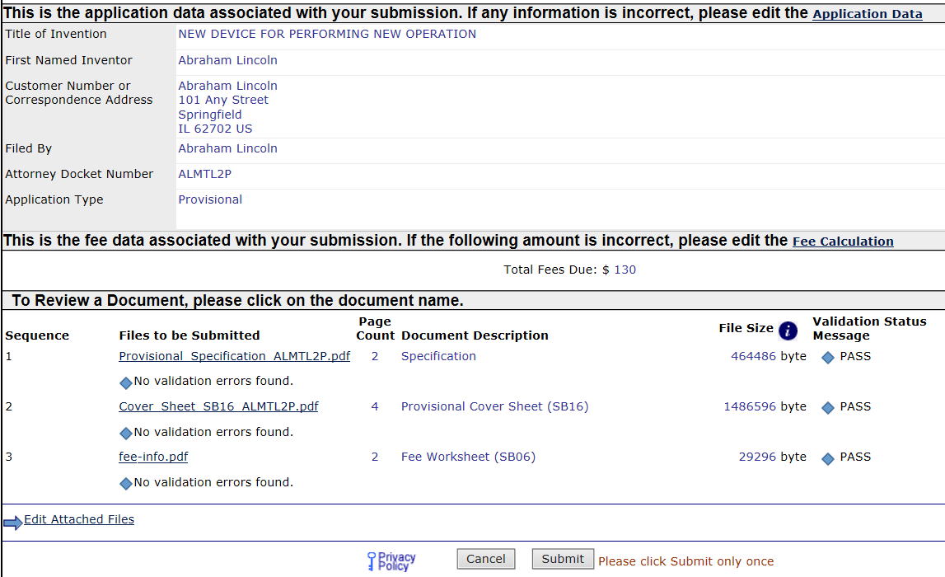
Filing Stage – Submit!
Now click Submit

Slide 62
Filing Stage – Ack
Then, this screen
confirms that you submitted something, …

Slide 63
Filing Stage – Ack
Then, this screen
confirms that you submitted something, and
shows the numbers assigned internally to this submission.

Slide 64
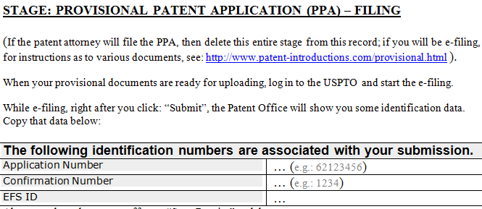
Filing Stage – Ack
Have you prepared your Personal Patent Organizer?

Slide 65
Filing Stage – Ack
Have you prepared your Personal Patent Organizer?
If so, copy & paste these numbers directly to it!

Slide 66
Filing Stage – Ack
Even if not, try to capture this number some other way now, in case there is an error in the session before you finish the filing.

Slide 67
Filing Stage – Ack
This number is also called the “Serial Number”. You will see it:
for computer purposes, as these 8 digits (e.g. 62404684)
on legal forms with separators (e.g. 62/404,684)

Slide 68
Filing Stage – Pay Fees
It is now time to pay the fees.

Slide 69
Filing Stage – Pay Fees
Click on: “YES! I want to pay now.”
(Paying later will cost you a surcharge.)

Slide 70
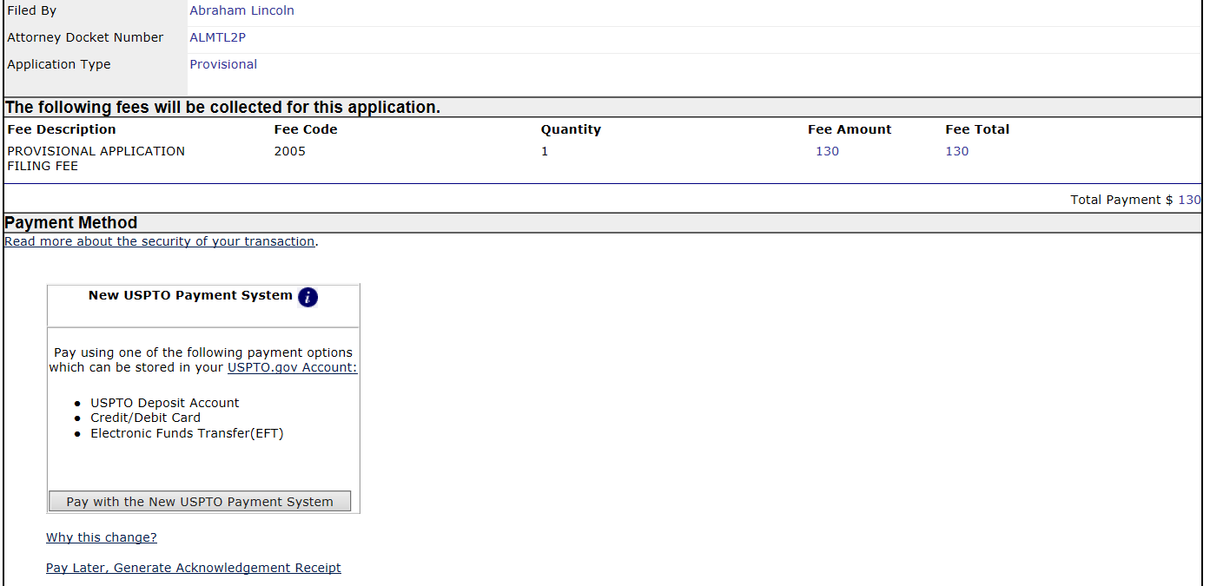
Filing Stage – Pay Fees
You get the Payment screen. Click here

Slide 71
Filing Stage – Pay Fees
… and try to: Pay as a guest

Slide 72
Filing Stage – Pay Fees
Then comes a straightforward credit card payment.

Slide 73
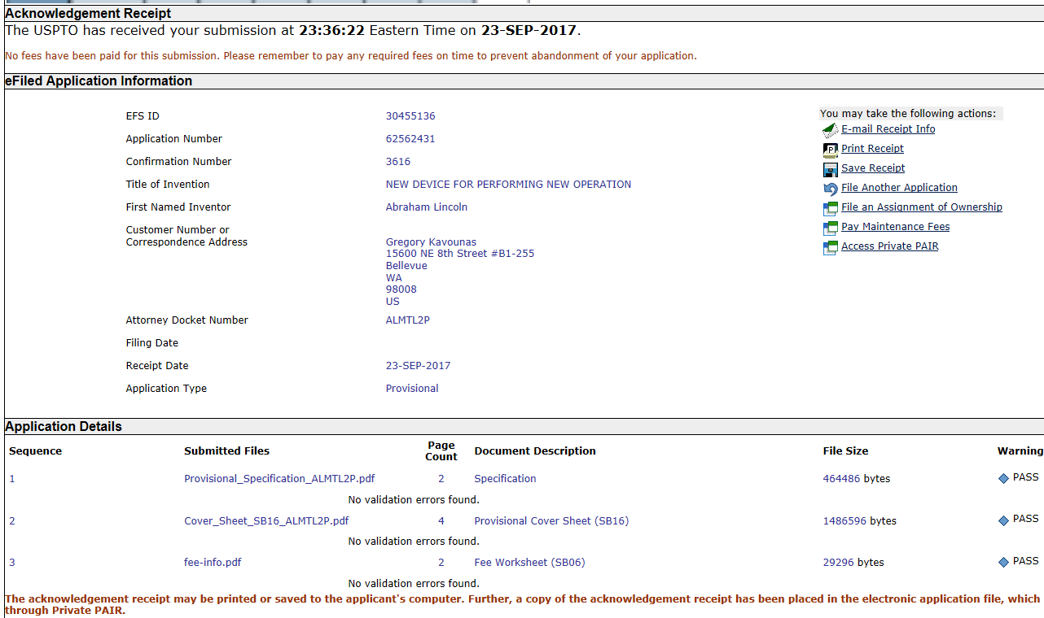
Filing Stage – Ack
After paying, you get this acknowledgement screen.

Slide 74
Filing Stage – Ack
VERY IMPORTANT: Click on “Save Receipt”, and save a copy on your desktop.

Slide 75
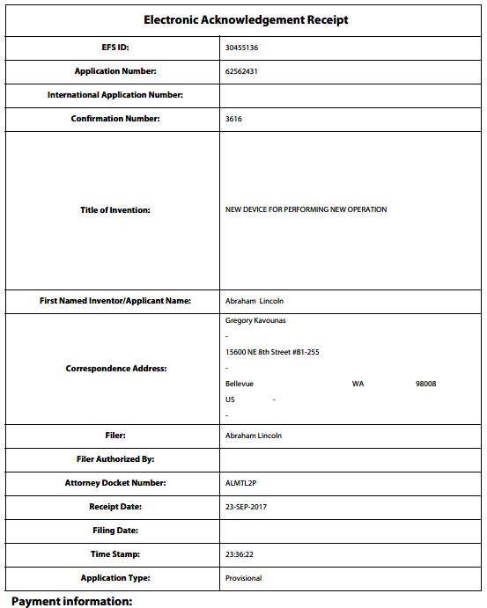
Filing Stage – Ack
This saved document is called the “EfileAck”; its first page will look like this.

Slide 76
Diligence after filing
IMPORTANT: Even though your electronic filing is now done, you still have diligence to do.
Some of that diligence is described in the Provisional Filing Portal™ webpage of this presentation, which is at: www.patent-introductions.com/provisional.html
Want to learn more about patents? (does your company need an expert on patents and you want to help?)
Try: www.patent-ready.com
Have a quick question about patents?
See: www.patent-ready.com, page for Engineers
GOOD LUCK!

